Slide 1
Graph-Based Classification of Web Documents
Enhancing Document Classification using Directed Graphs and K-Nearest Neighbors Algorithm
Supervised by: Mr. Waqas Ali
M Abdullah 2021-CS-104

Slide 2
Introduction
Importance of Document Classification in web content
Challenges in managing textual data effectively
Innovative approach using graph theory and ML
Introduction to the concept of graph-based classification

Slide 3
Objective
Improving classification accuracy with novel methods
Practical experience in data representation
Exploring the convergence of graph theory and ML
Enhancing document classification techniques

Slide 4
Milestones
Data collection and its importance in classification
Building graphs for text document analysis
Extracting features using common subgraphs
Implementation of KNN algorithm for classification

Slide 5
Data Collection
Using Selenium for web scraping
Identifying relevant websites for data extraction
Custom scripts for extracting data efficiently
Utilizing XPath and CSS selectors for content extraction

Slide 6
Text Preprocessing
Lowercasing text for uniformity
Tokenization to break text into words
Removing stopwords and non-alphabetic characters
Stemming to normalize word forms

Slide 7
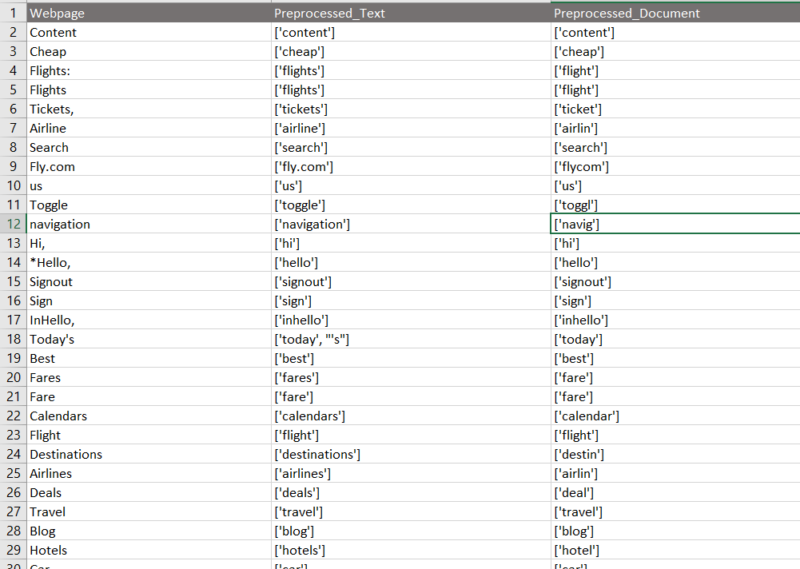
Data Pre Processing

Slide 8
Graph Construction
Iterative process for building graphs
Adding nodes for unique words in documents
Creating edges for co-occurrence analysis
Appending graphs to relevant topics

Slide 9
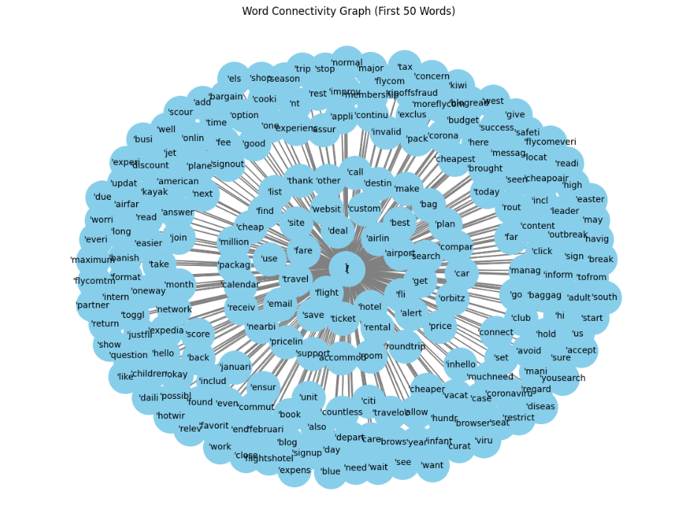
Graph

Slide 10
Frequent Subgraph Mining
Overview of gSpan algorithm for subgraph mining
Creating composite graphs using NetworkX
Defining gSpan arguments and execution steps
Handling challenges in CPU usage and feature extraction

Slide 11
KNN Classification
Understanding KNN algorithm for classification
Predicting classes based on nearest neighbors
Effective machine learning technique for classification tasks
Implementing KNN for document classification

Slide 12
Challenges
Initial hurdles with MCS generation and CPU issues
Subsequent challenges with feature extraction
Importance of overcoming challenges for model improvement
Continuous improvement for better classification results

Slide 13
Future Work
I will focus on improving the model's accuracy

Slide 14
Thank You
Any Questions?

